Slide 1
CMSE 830 • MIDTERM PROJECT
FALL 2026
Why does this
song
feel like that?
Explore the audio features behind the vibe —
and find songs that match it.
VALENCE × ENERGY
28,356 UNIQUE SONGS
FOUR WAYS TO FEEL A SONG
Aayushi Malhotra
Foundations of Data Science • Dr. Jie Hou

Slide 2
CMSE 830 / SPOTIFY MOOD EXPLORER
MIDTERM 2026
01 / DATA PREP
From playlist rows to music moods
Two decisions that made the later analysis easier to trust.
01 • CLEANING
02 • NEW MOOD GROUPS
32,833
28,356
2 audio features → 4 groups
Valence = positivity • Energy = intensity
rows in the CSV
unique songs
4,477 repeated track IDs
Angry / Tense
Happy / Energetic
The same track can appear in more than one playlist.
Sad / Mellow
Chill / Content
For genre comparisons, I kept each song once per genre.
0.5 cutoff on each 0–1 feature; a useful grouping, not a mood rating.
WHY DOES THIS SONG FEEL LIKE THAT?
02 / 05

Slide 3
CMSE 830 / SPOTIFY MOOD EXPLORER
MIDTERM 2026
02 / EXPLORATION
A genre can have more than one vibe
Percentage of tracks in each mood group, counted once per genre.
Sad / mellow
Angry / tense
Chill / content
Happy / energetic
THE QUICK TAKE
EDM
84.8%
Latin
of unique songs are high-energy
Pop
63.6%
R&B
EDM: angry / tense
Rap
63.0%
Rock
Latin: happy / energetic
0%
25%
50%
75%
100%
Mood here means valence + energy buckets, not listeners’ reported emotions.
WHY DOES THIS SONG FEEL LIKE THAT?
03 / 05

Slide 4
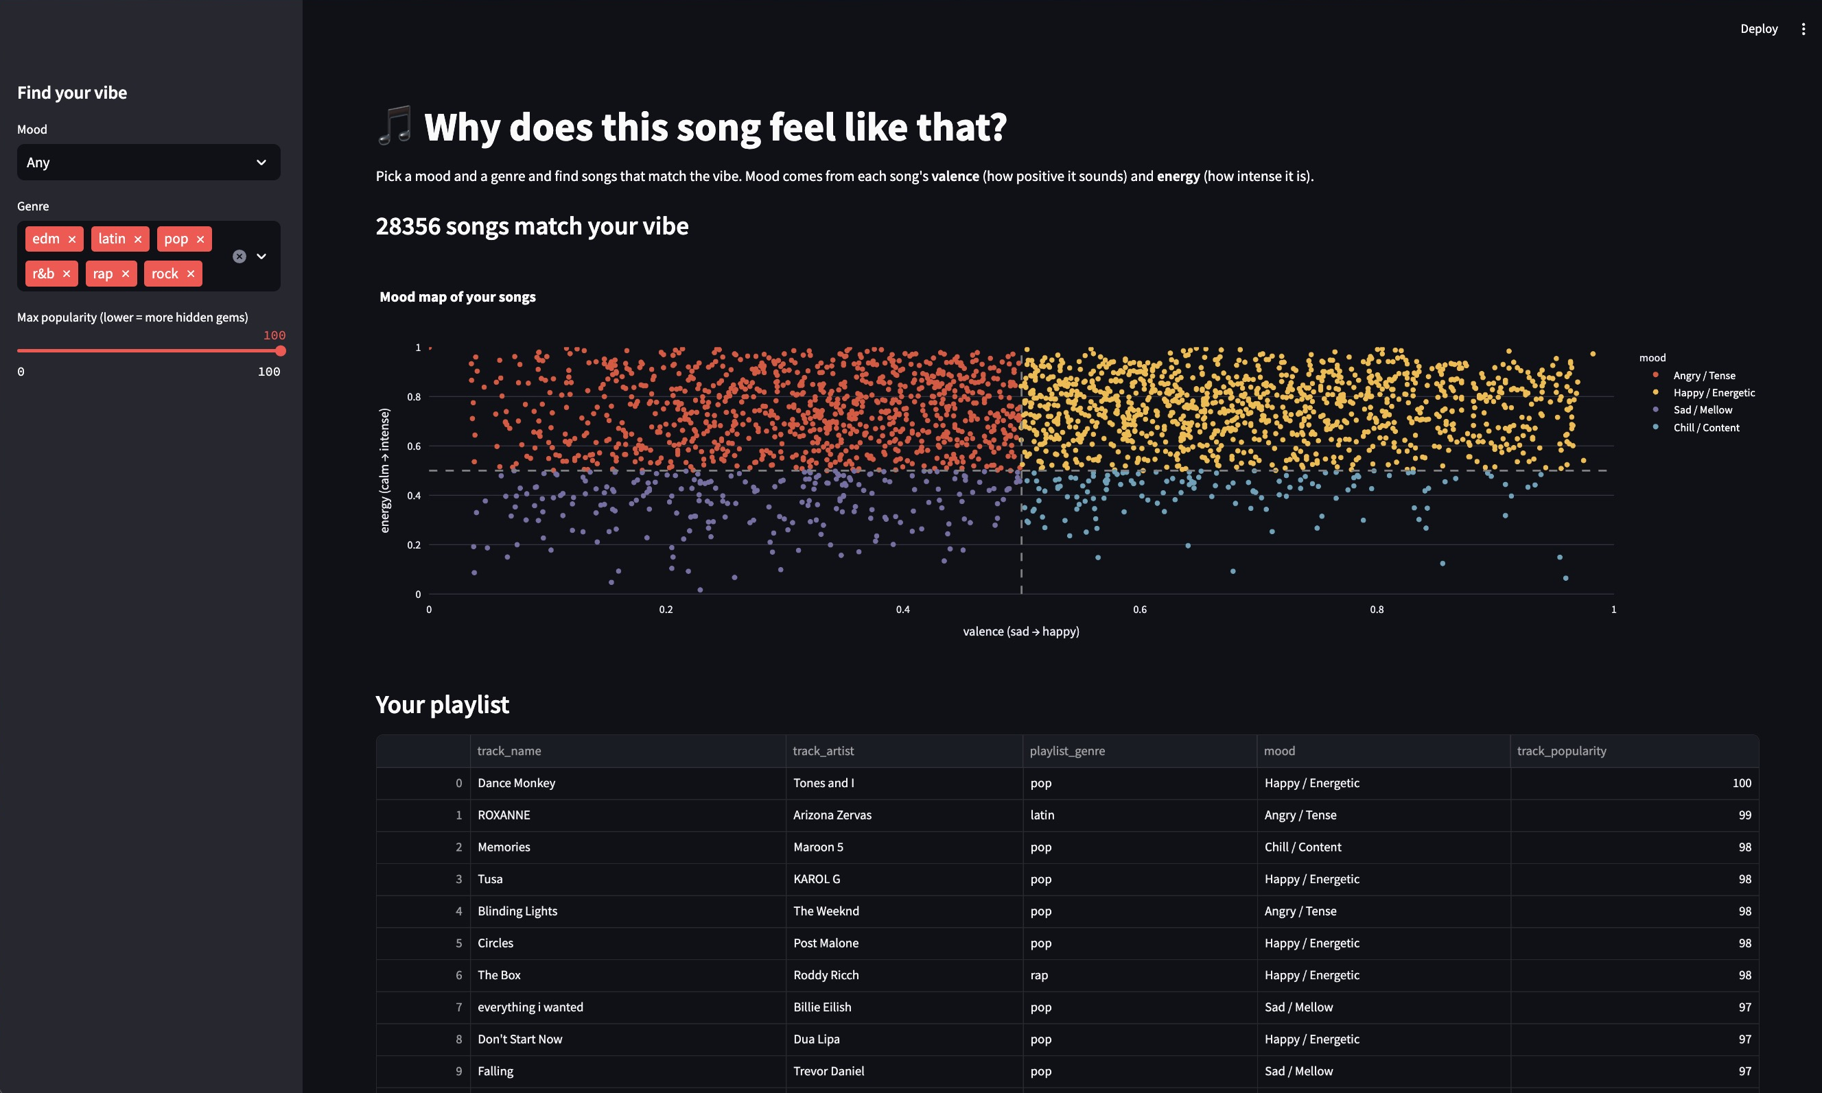
CMSE 830 / SPOTIFY MOOD EXPLORER
MIDTERM 2026
03 / STREAMLIT
From the EDA to a song finder
This is the working local prototype. The filters update both the map and the song list.
WORKING PROTOTYPE
01
Pick a mood
Happy, mellow, chill or tense.
02
Narrow the list
Genre + popularity filters.
03
See the matches
Mood map and playlist table.
LIVE DEMO →
WHY DOES THIS SONG FEEL LIKE THAT?
04 / 05

Slide 5
CMSE 830 / SPOTIFY MOOD EXPLORER
MIDTERM 2026
04 / REFLECTION
What the app can’t tell us (yet)
Useful for exploring a vibe — but not a universal definition of mood.
LIMITATIONS
WHAT I WANT TO BUILD NEXT
Not actual emotions
Find similar songs
The groups come from two audio features, not listener ratings.
Start with one song and explore tracks with a similar vibe.
Playlist genres
Handle genres better
A playlist tag isn’t necessarily a track’s only genre.
Let songs belonging to multiple genres show up in each.
Still a starting point
Improve the experience
This set of playlists does not represent all music.
Try it with a new user and make the controls clearer.
CODE + DATA → github.com/aayushimalhotra3/cmse830-midterm-project
WHY DOES THIS SONG FEEL LIKE THAT?
05 / 05

